Slide 1
ShanghaiTech University
EE 115B: Digital Circuits
Fall 2024
Lecture 7
Hengzhao Yang
October 22, 2024

Slide 2

EE115 Analog and Digital Circuits
Topic 6: Combinational Logic
Prof. Yajun Ha
ShanghaiTech University
Shanghai, China
This set of slides is by © Pearson Education

Slide 3
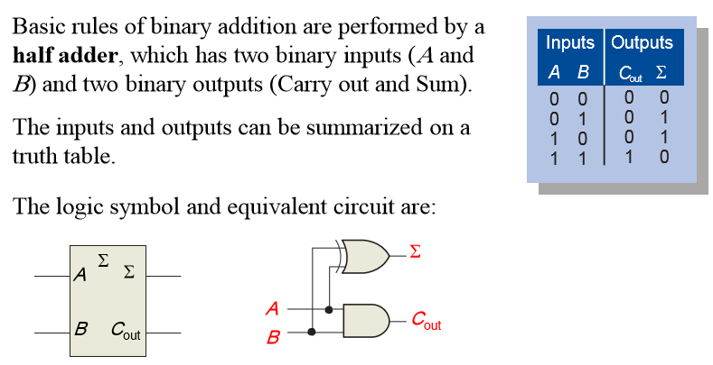


Half-Adder

Slide 4
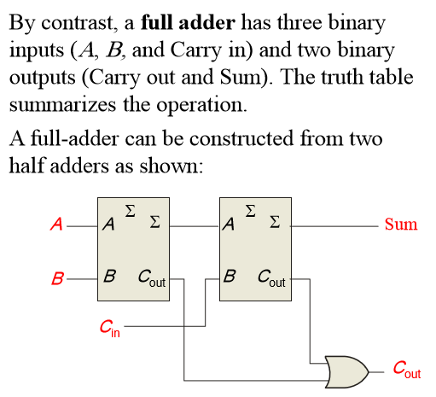
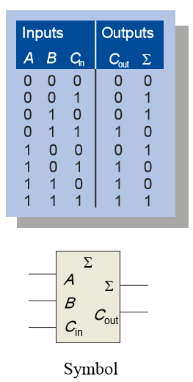
Full-Adder
Notes:
Title

Slide 5
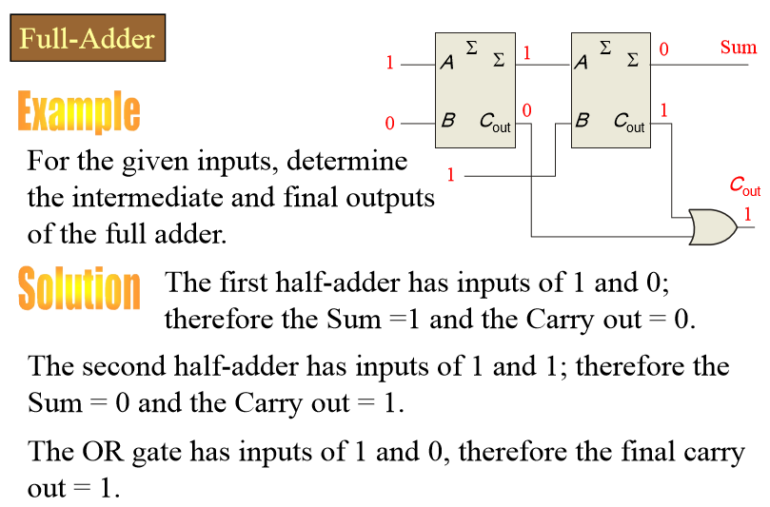
Full-Adder
Notes:
Title

Slide 6
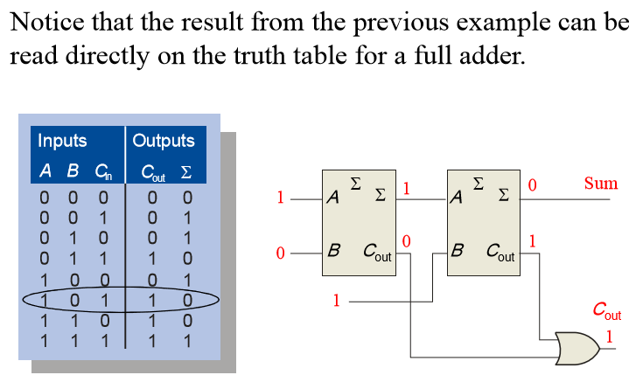
Full-Adder

Slide 7
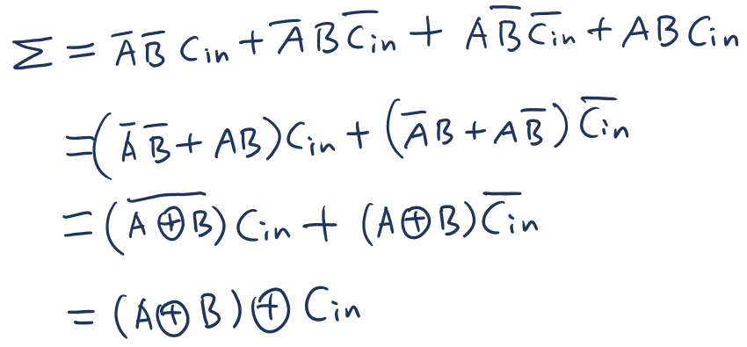
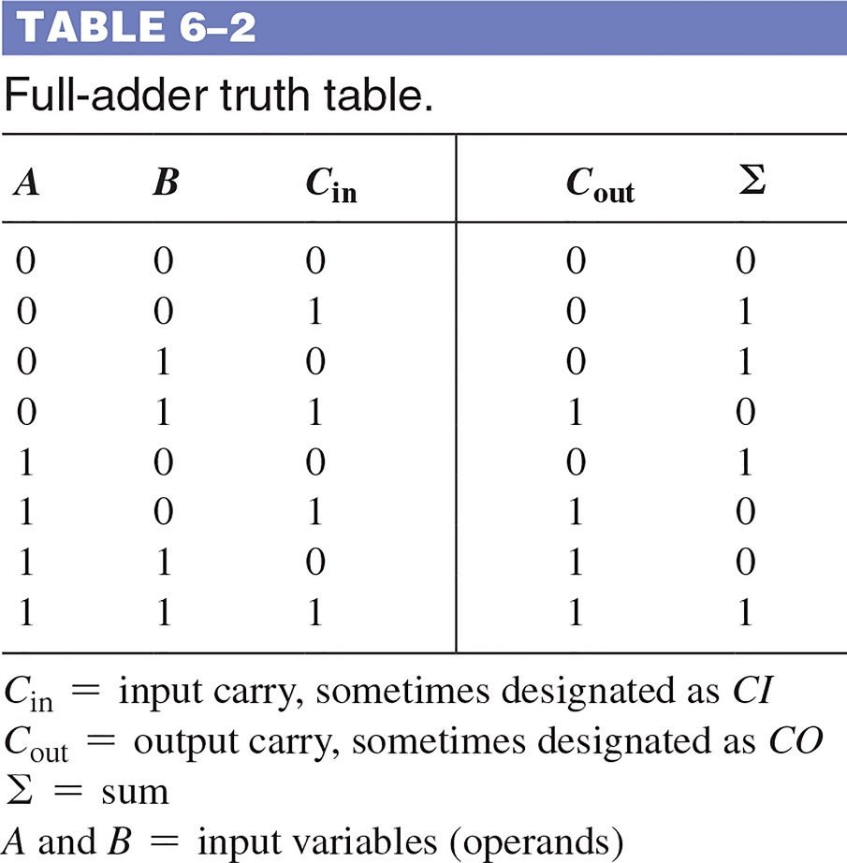
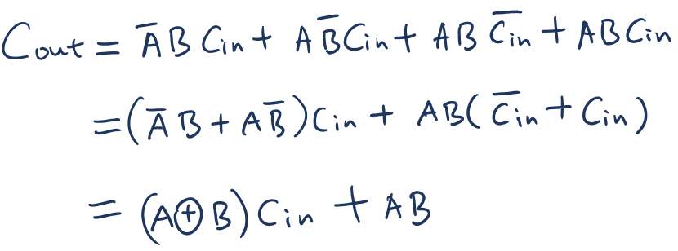
Full-Adder: output functions
_____________________________________________

Slide 8
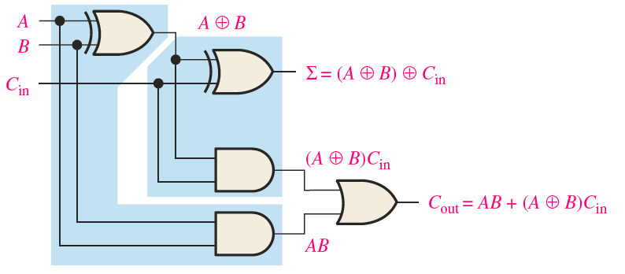
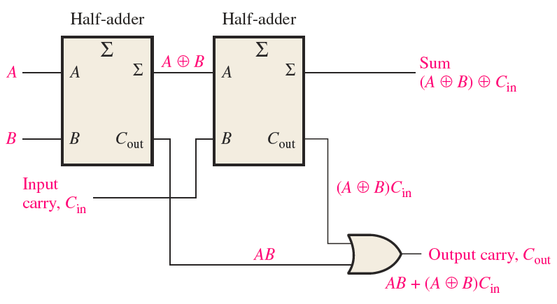
Full-Adder: implementation
_____________________________________________

Slide 9
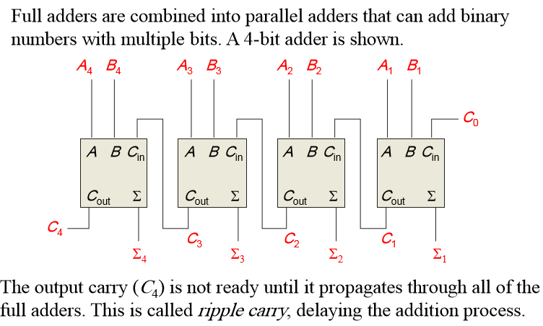
Parallel Adders: Ripple Carry
Notes:
Title

Slide 10
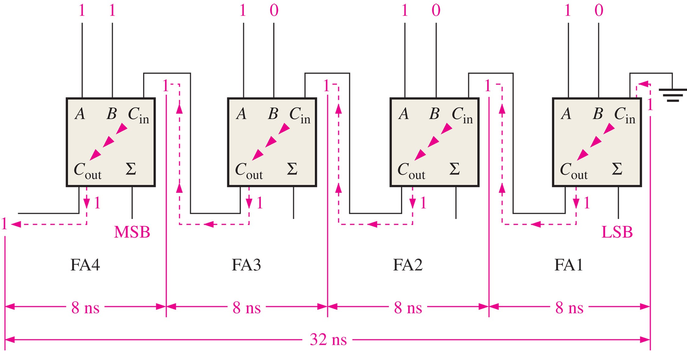
FIGURE 6-14 A 4-bit parallel ripple carry adder showing “worst-case” carry propagation delays.

Slide 11
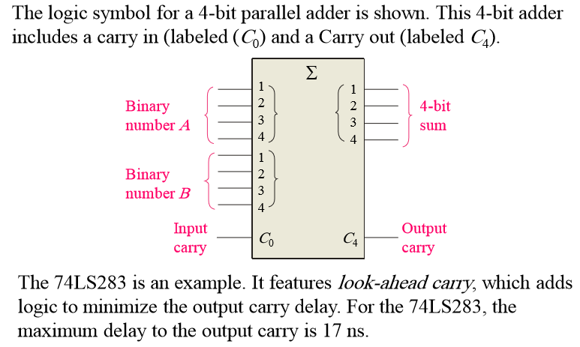
Parallel Adders: Look-Ahead Carry
Notes:
Title

Slide 12
Output carry
_____________________________________________
Carry generation occurs when an output carry is produced internally
C_{g}=AB
Carry propagation occurs when input carry is rippled to become output carry
C_{p}=A+B
Output carry
C_{out}=C_{g}+C_{p}C_{in}
For each stage, output carry is dependent on initial input carry (i.e., input carry to the first LSB stage) and inputs to itself and preceding stages (C_{g} and C_{p} are only dependent on A and B)

Slide 13
Output carry
_____________________________________________

Slide 14
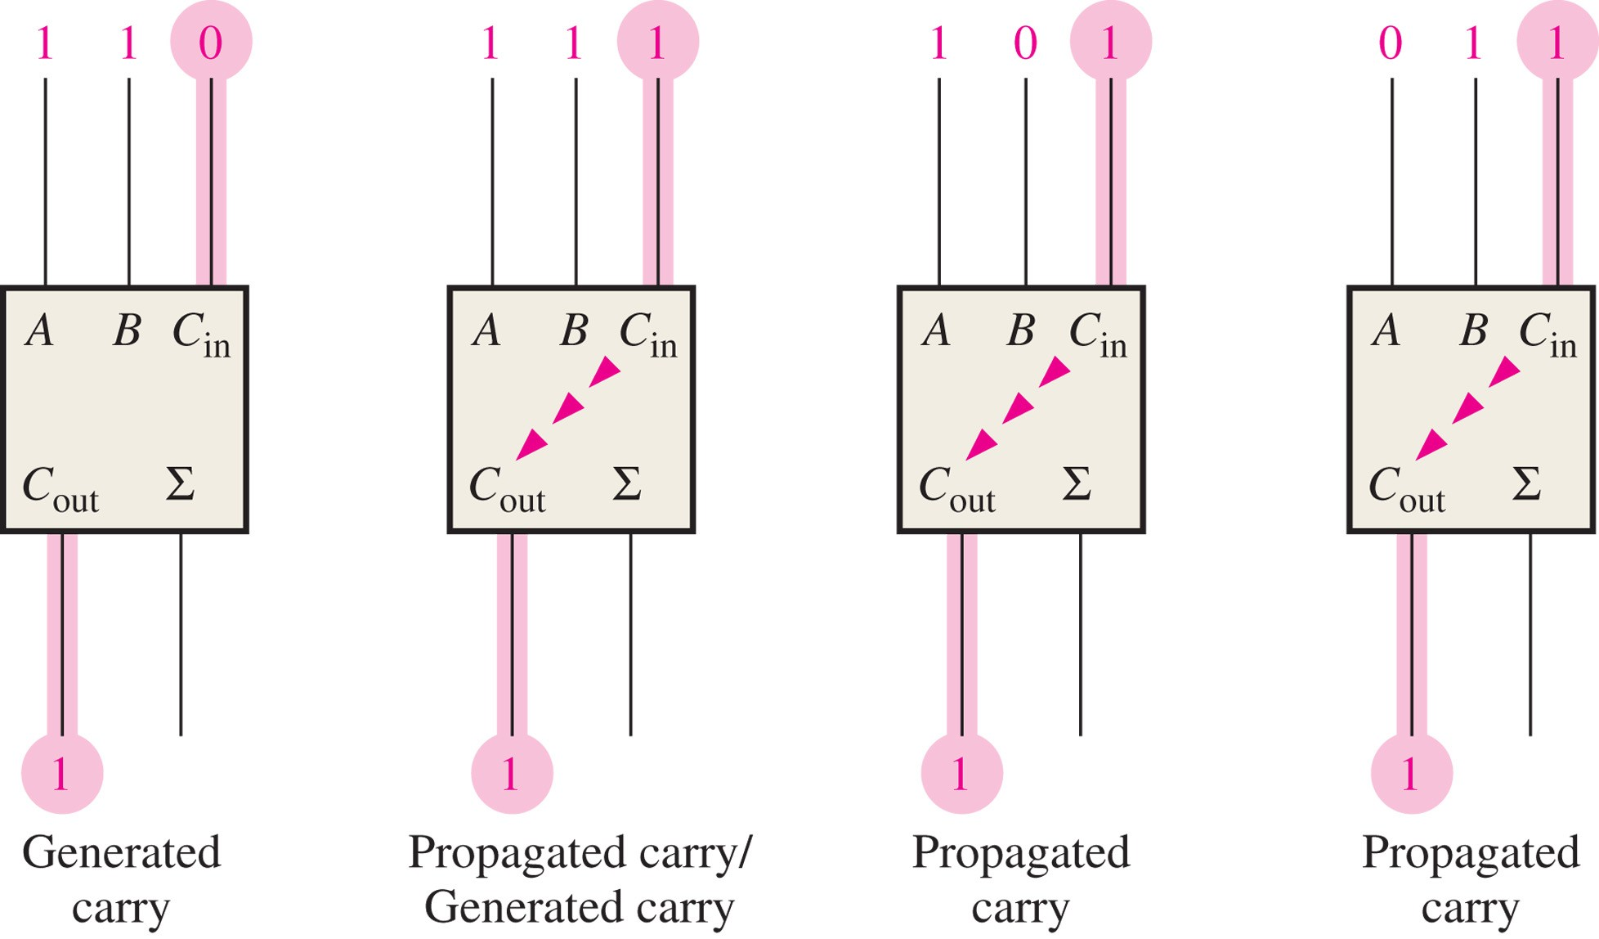
FIGURE 6-15 Illustration of conditions for carry generation and carry propagation.

Slide 15
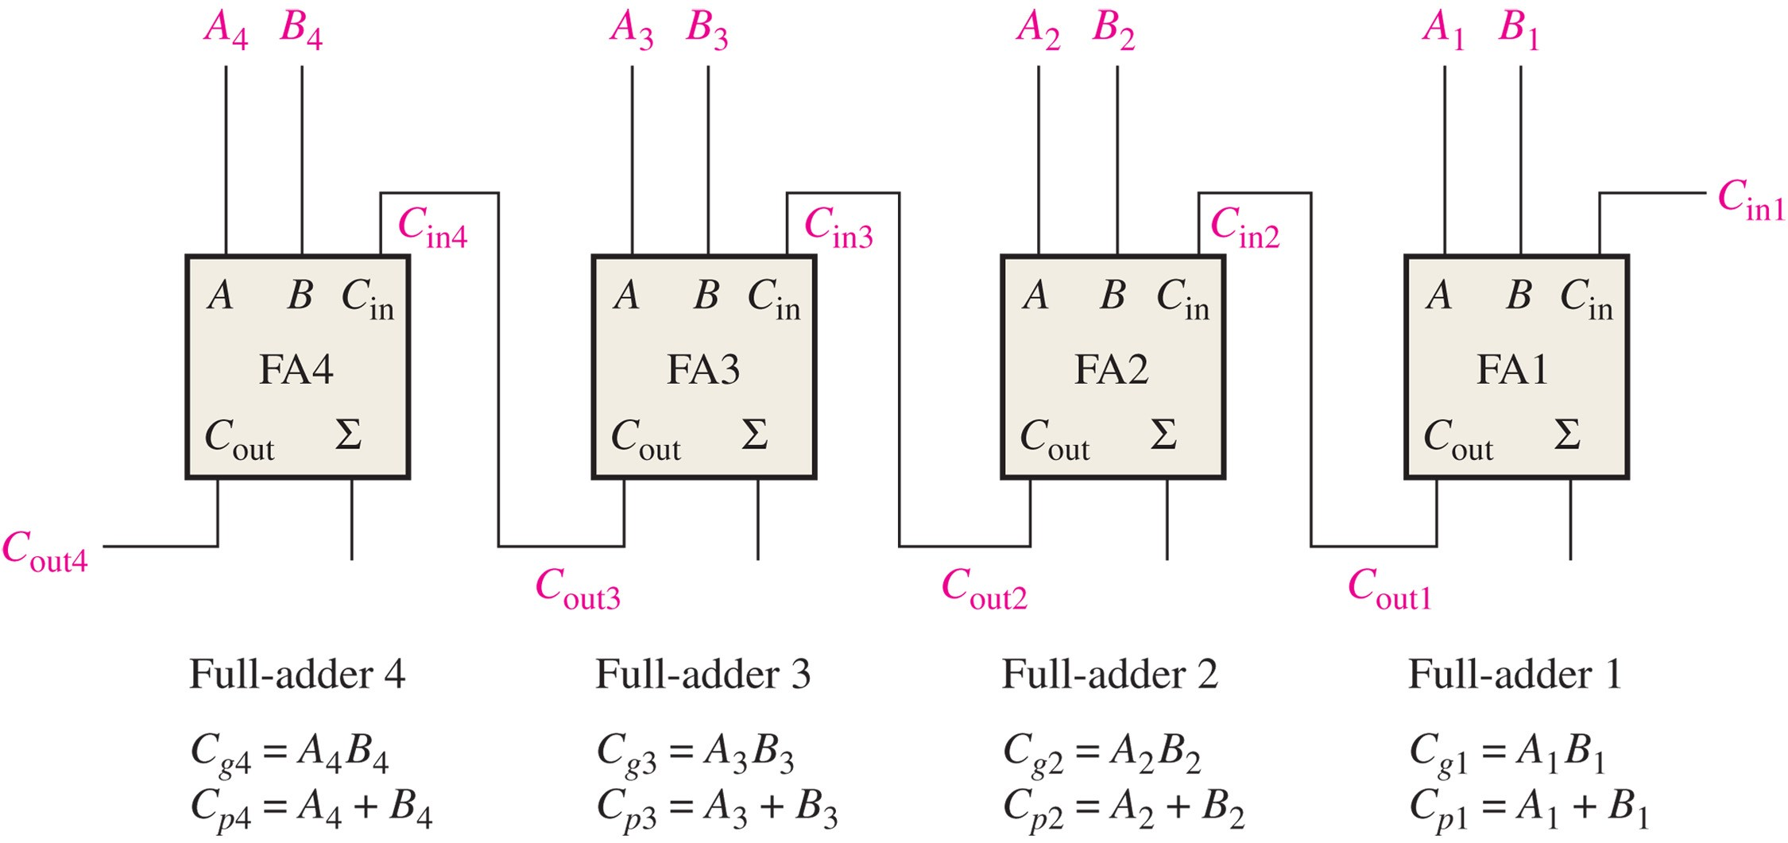
FIGURE 6-16 Carry generation and carry propagation in terms of the input bits to a 4-bit adder.

Slide 16
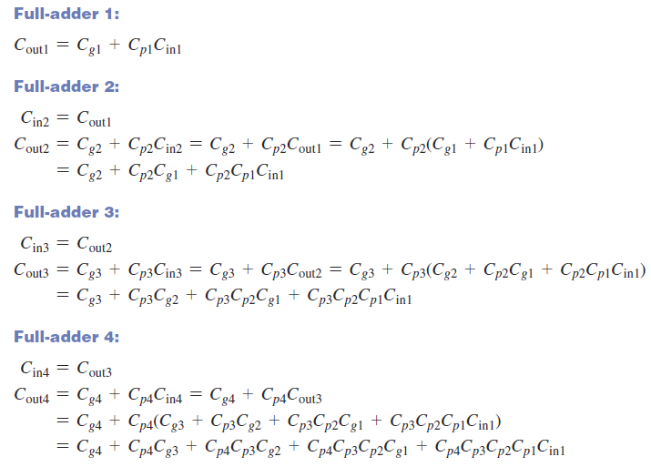


Slide 17
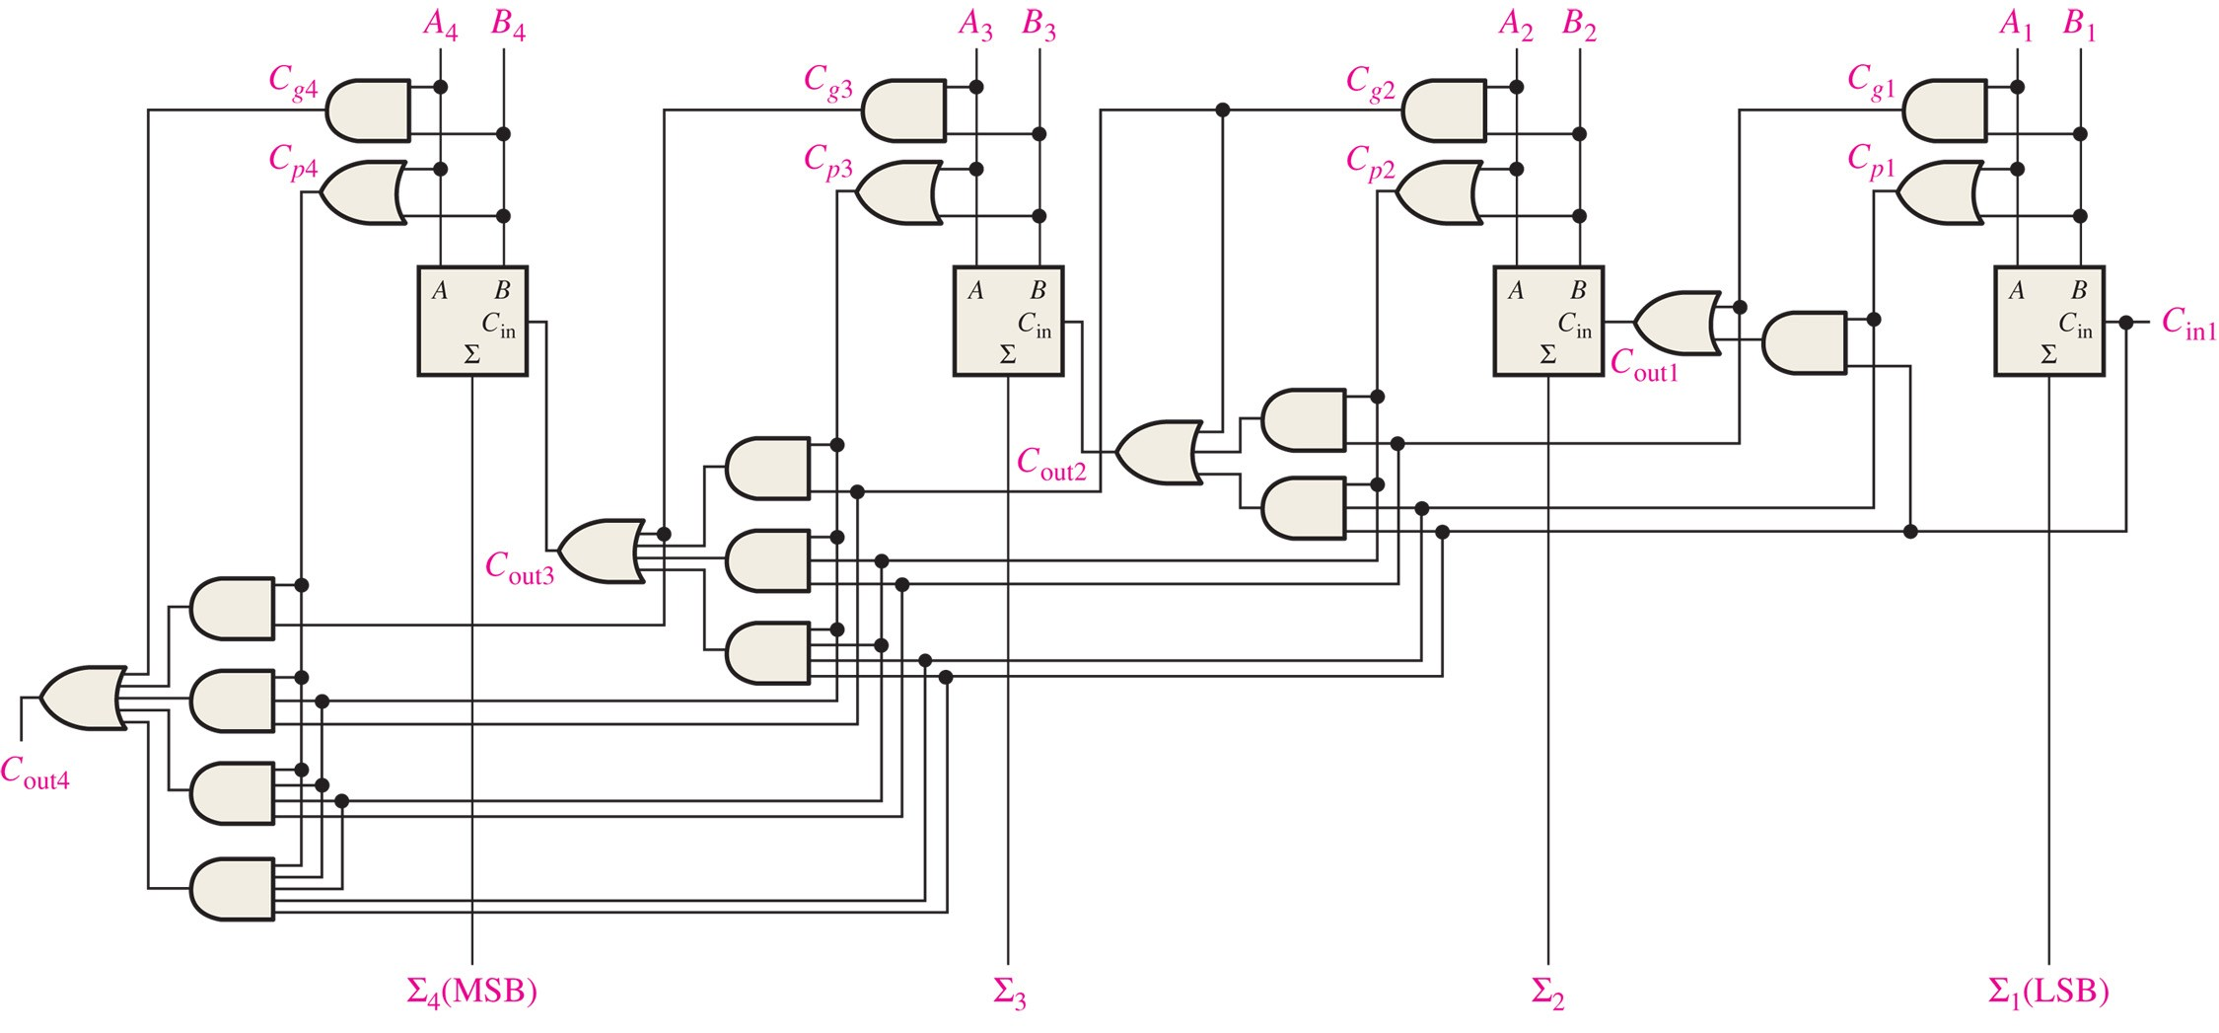
FIGURE 6-17 Logic diagram for a 4-stage look-ahead carry adder.

Slide 18
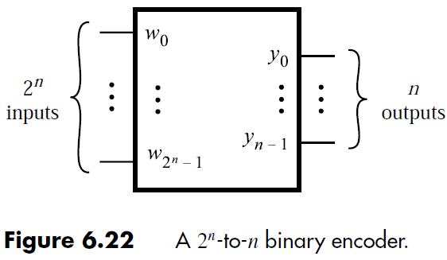
Encoders
Encoders: encode information in a more compact form.
Binary encoders: encode information from 2^{n} inputs into an n-bit code.
Exactly one input is high and output identifies that input.
Prof. Yajun Ha

Slide 19
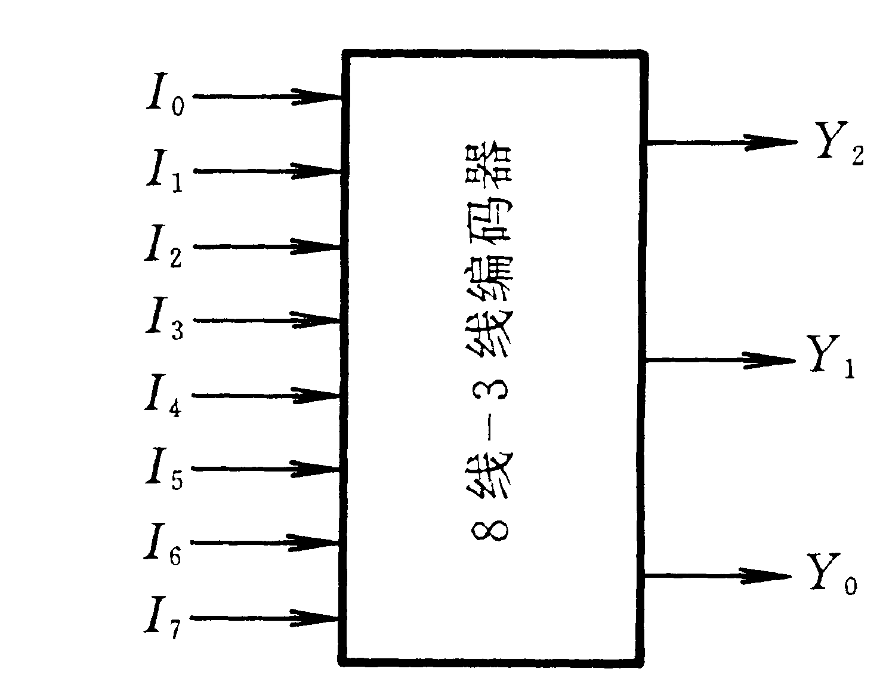
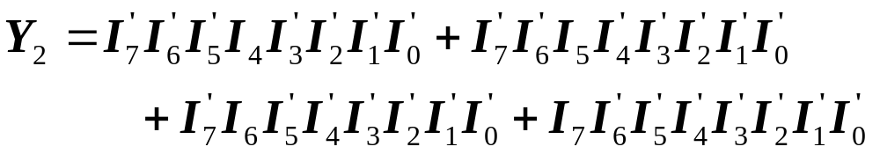
一、8-3编码器
输 入 |  |  |  |  |  |  |  | 输 出
I₀ | I₁ | I₂ | I₃ | I₄ | I₅ | I₆ | I₇ | Y₂ | Y₁ | Y₀
1 | 0 | 0 | 0 | 0 | 0 | 0 | 0 | 0 | 0 | 0
0 | 1 | 0 | 0 | 0 | 0 | 0 | 0 | 0 | 0 | 1
0 | 0 | 1 | 0 | 0 | 0 | 0 | 0 | 0 | 1 | 0
0 | 0 | 0 | 1 | 0 | 0 | 0 | 0 | 0 | 1 | 1
0 | 0 | 0 | 0 | 1 | 0 | 0 | 0 | 1 | 0 | 0
0 | 0 | 0 | 0 | 0 | 1 | 0 | 0 | 1 | 0 | 1
0 | 0 | 0 | 0 | 0 | 0 | 1 | 0 | 1 | 1 | 0
0 | 0 | 0 | 0 | 0 | 0 | 0 | 1 | 1 | 1 | 1
功能：将输入信号编为二进制代码
特点：任何时刻只允许输入一个编码信号
例：3位二进制普通编码器

Slide 20
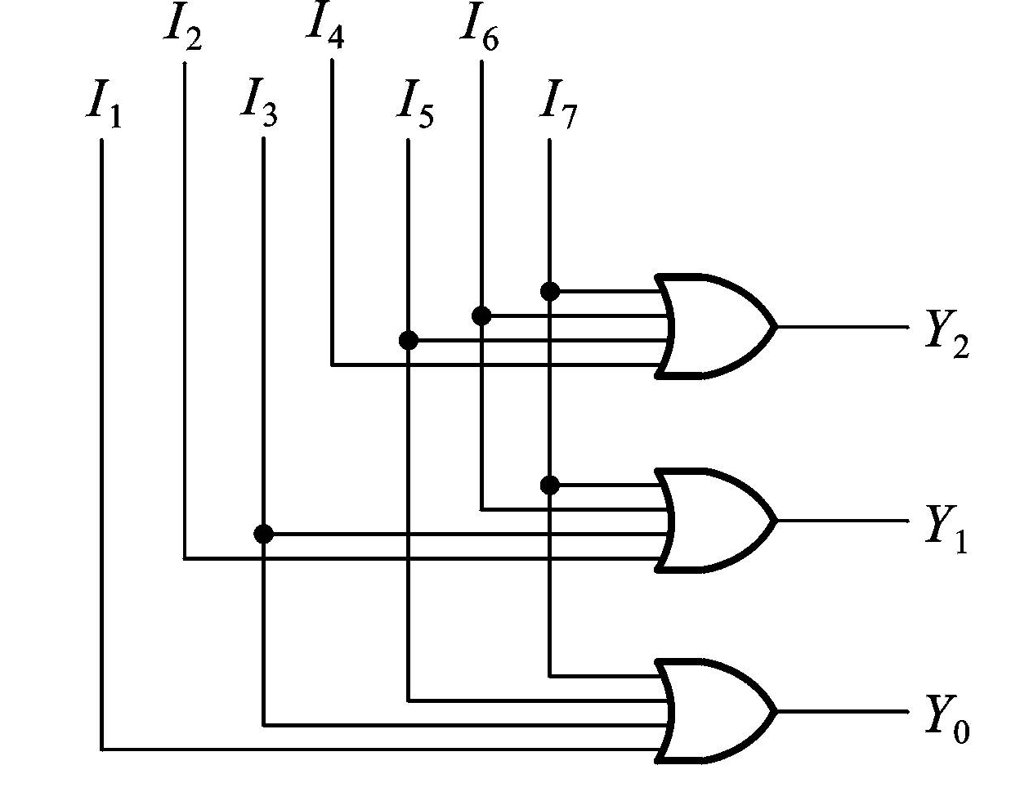
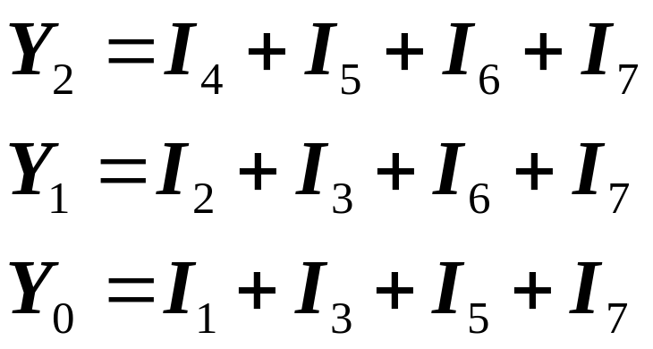
利用无关项化简，得：

